Slide 1
COST FinAI annual meeting
Lithuanian Node of FinAI

Slide 2
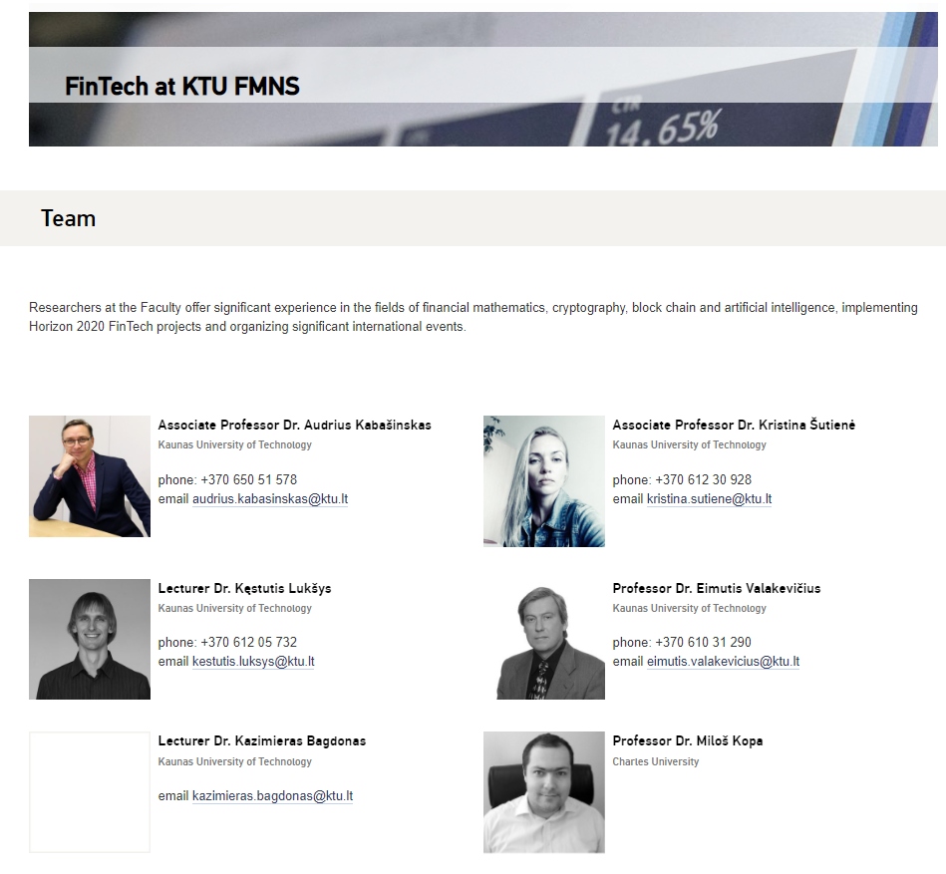

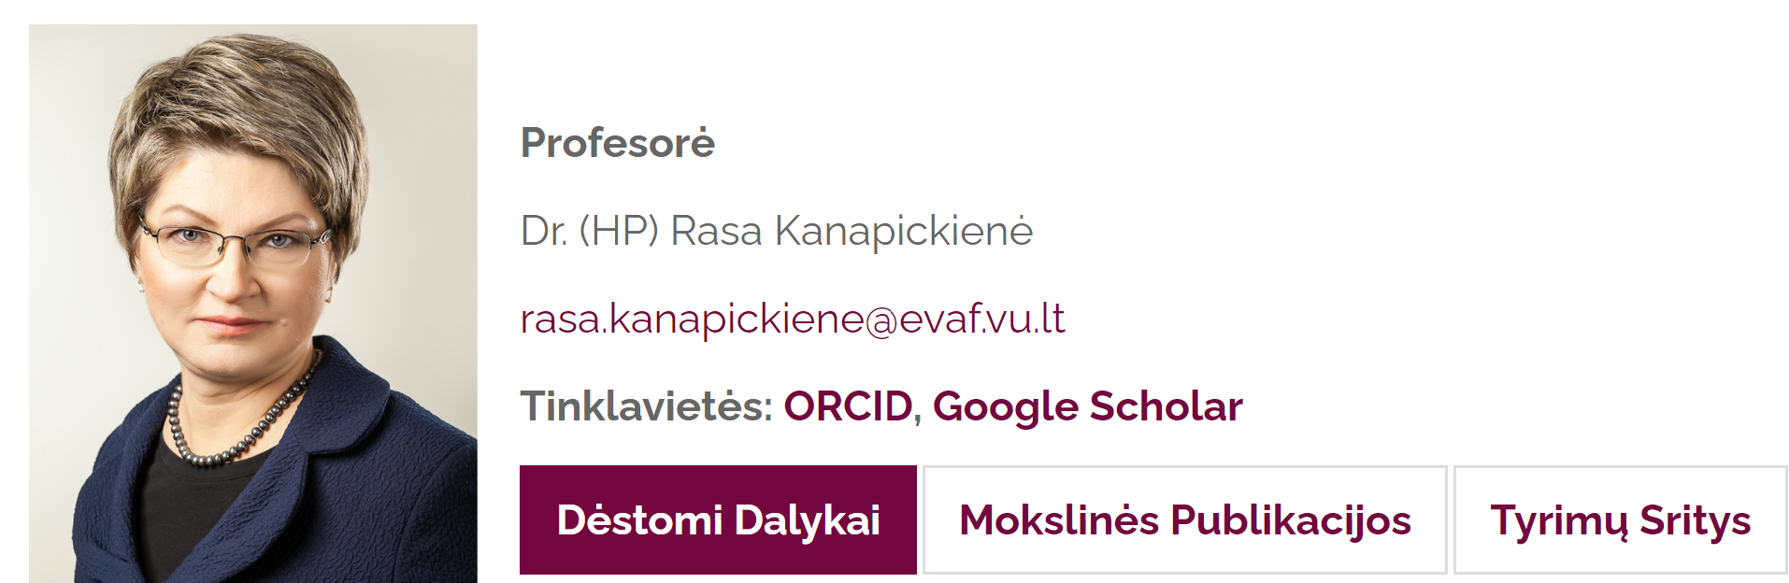
Who we are
Kaunas University of Technology (KTU)
MC Members:
Kristina Šutienė (KTU), WG2 Co-leader
Deimantė Teresienė (VU)
MC Substitute Members:
Audrius Kabašinskas (KTU), Coordinator of network expansion
Rasa Kanapickienė (VU)
Jurgita Černevičienė (KTU)
Interdisciplinary background : AI, Quantitative Methods, Finance and Economics
Vilnius University
Associate Professor Dr. Deimantė Teresienė
Professor Dr. Rasa Kanapickienė

Slide 3
How we contribute
Papers and presentations with COST FinAi acknowledgement:
Sutiene, K., Schwendner, P., Sipos, C., Lorenzo, L., Mirchev, M., Lameski, P., Kabasinskas, A., Tidjani, C., Ozturkkal, B., & Cerneviciene, J. (2024). Enhancing portfolio management using artificial intelligence: literature review. Frontiers in Artificial Intelligence, 7. doi: 10.3389/frai.2024.1371502
Černevičienė J and Kabašinskas A (2022) Review of Multi-Criteria Decision-Making Methods in Finance Using Explainable Artificial Intelligence. Front. Artif. Intell. 5:827584. 10 March 2022. doi: 10.3389/frai.2022.827584
Kabašinskas, Audrius. Discussion on: “Programmable money: next generation blockchain based conditional payments” by Ingo Weber and Mark Staples : short communication // Digital finance. Lausanne : Springer. ISSN 2524-6984. eISSN 2524-6186. 2022, vol. 4, iss. 2-3, p. 135. DOI: 10.1007/s42521-022-00062-w

Slide 4
How we contribute
Papers and presentations with COST FinAi acknowledgement (continued):
FinAI COST Action Podcast #2 - Audrius Kabašinskas, https://www.youtube.com/watch?v=foYG70ZYvMY
ECI: „Explainable Cryptocurrency Steep Price Movement Prediction Using Reddit Messages And Technical Indicators“, presentation by Dominykas Švedas and Kristina Šutienė, Croatia, WG2 meeting (in-person), https://sites.google.com/net.efzg.hr/tinfinconference/
STAT of ML (Statistics of Machine Learning):"Explainable AI methods for early warning system of financial crises prediction", presentation by Jurgita Černevičienė, Prague (in-person), https://barunik.github.io/Prague2023/
Others:
Kristina Šutienė (together with Peter Schwendner) - a guest editor in Mathematics journal, SI: Applications and Mathematical Foundations of Machine Learning in Investments

